Slide 1
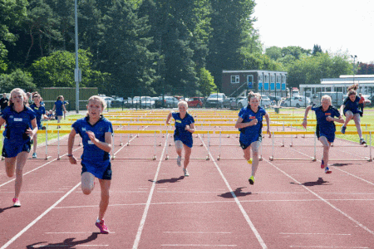
Sports Day
跳欄 - hurdles
跳遠 - long jump
接力賽跑 - relay race
跳高 - high jump
振作起来！ - Cheer up!
啦啦隊 - cheerleading

Slide 2
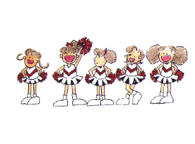
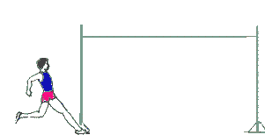
We were busy last weekend, but…..yes, we did.
Did you do your homework?

Slide 3
an apple
/æ/

Slide 4
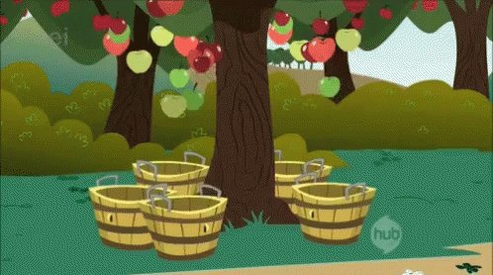
/æ/
apples

Slide 5
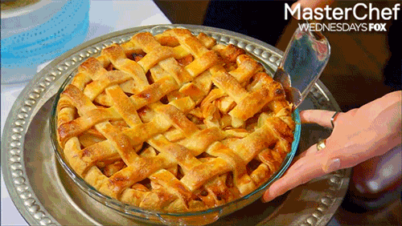
apple pie

Slide 6
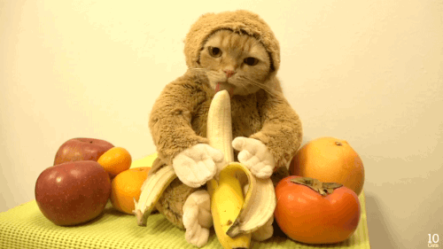
a banana
/ə/
/æ/
/ə/

Slide 7
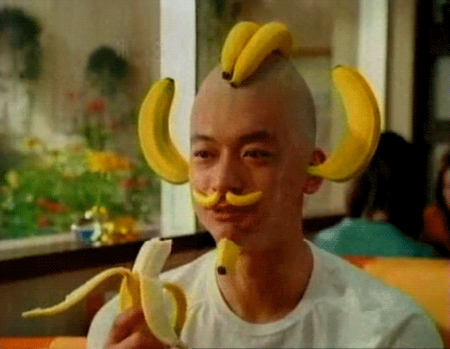
/ə/
/æ/
/ə/
bananas

Slide 8
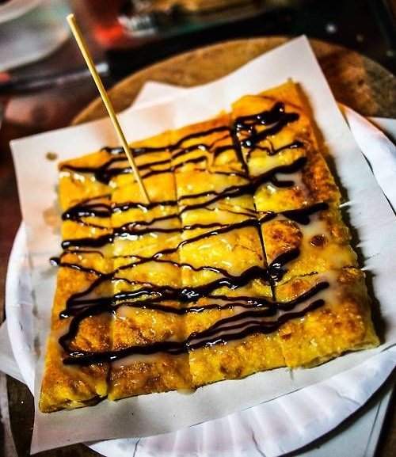
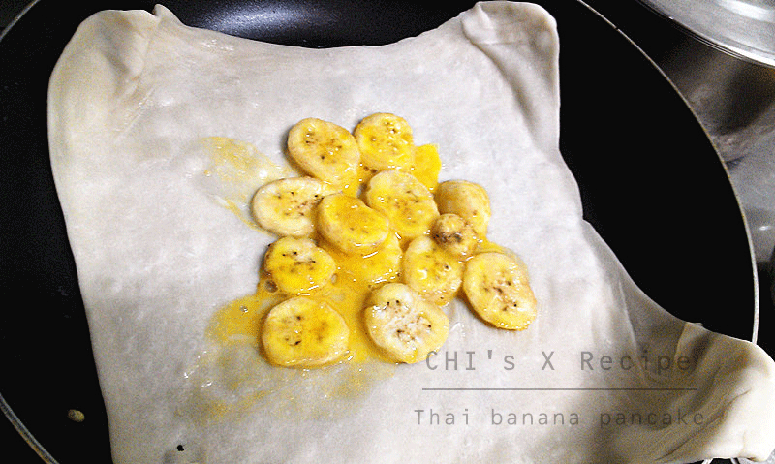
Thai banana pancake

Slide 9
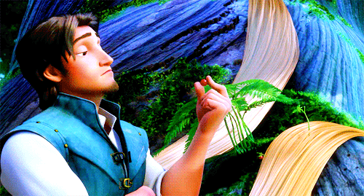
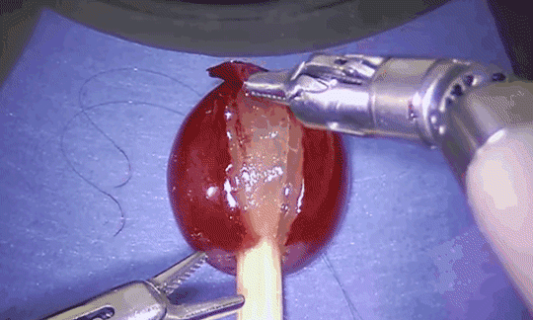
a grape
/e/

Slide 10
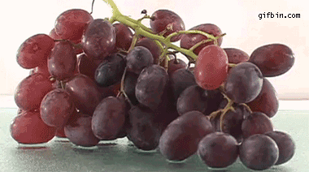
grapes
/e/

Slide 11
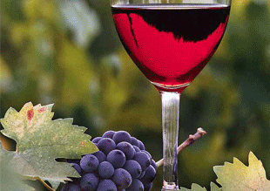
grape wine

Slide 12
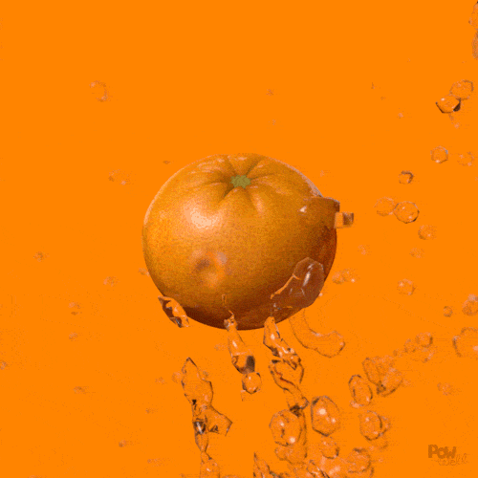
an orange
/ɪ/

Slide 13
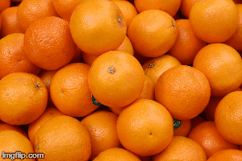
oranges
/ɪ/

Slide 14
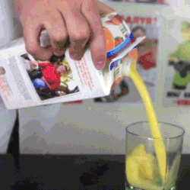
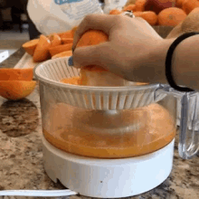
orange juice

Slide 15
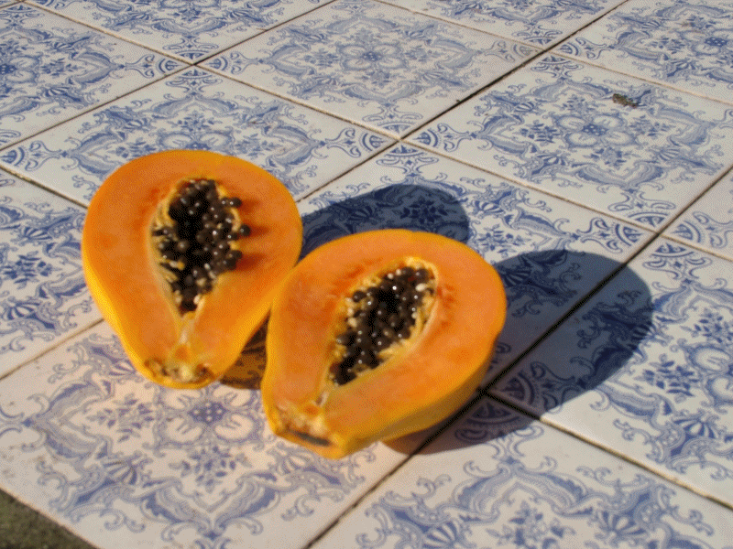
a papaya
/ə/
/aɪ/
/ə/

Slide 16
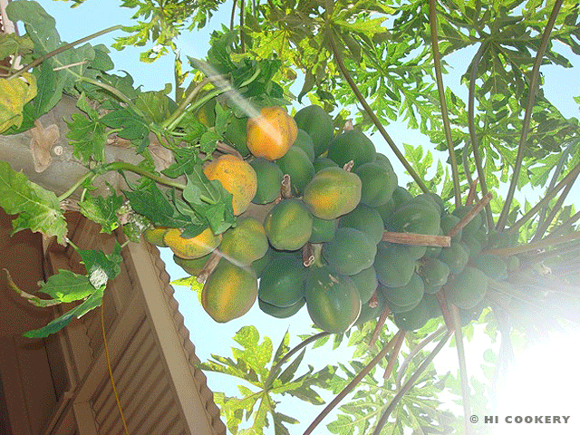
papayas
/ə/
/aɪ/
/ə/

Slide 17
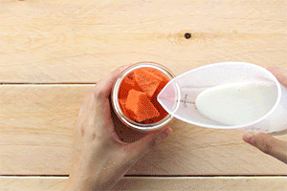
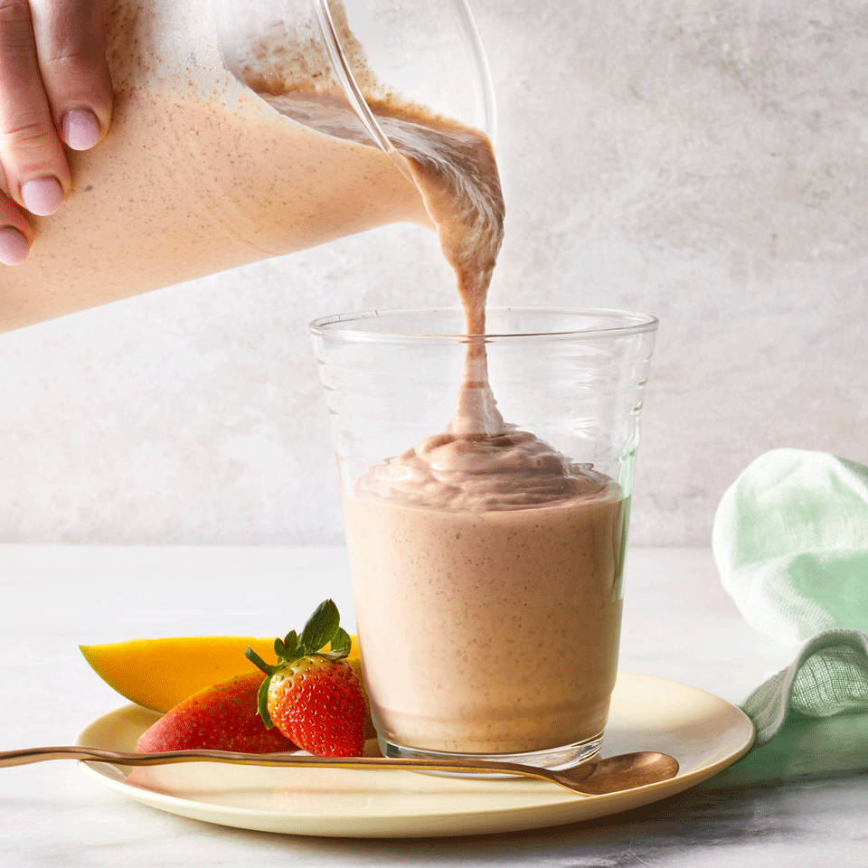
papaya milk/smoothie

Slide 18
a watermelon
/ɔ/

Slide 19
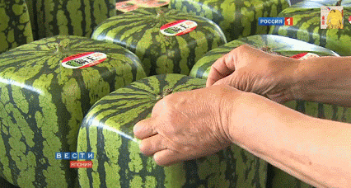
watermelons
/ɔ/

Slide 20
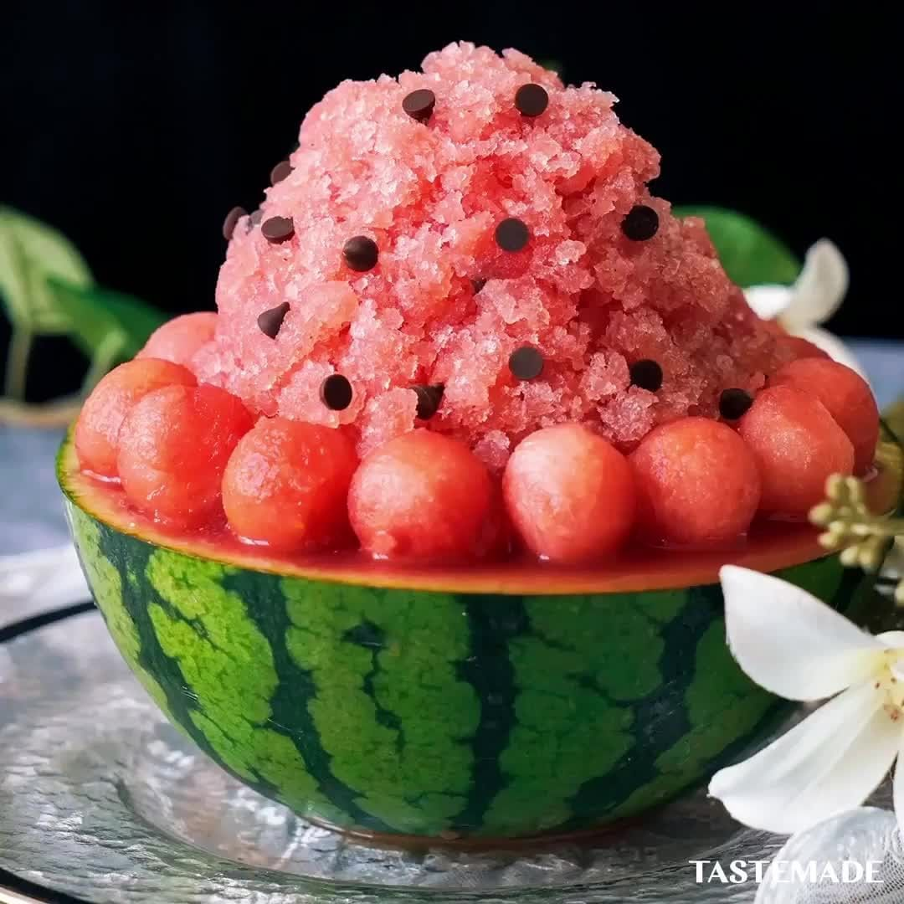
watermelon shaved ice

Slide 21
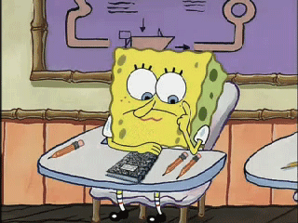
Vocabulary test

Slide 22
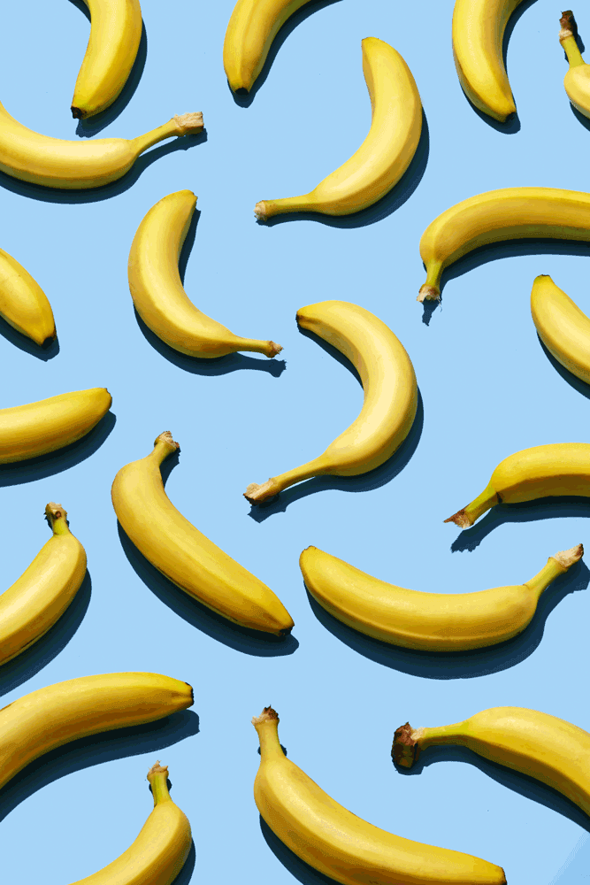
What are these? They’re _____.
banana
bananas
ballons

Slide 23
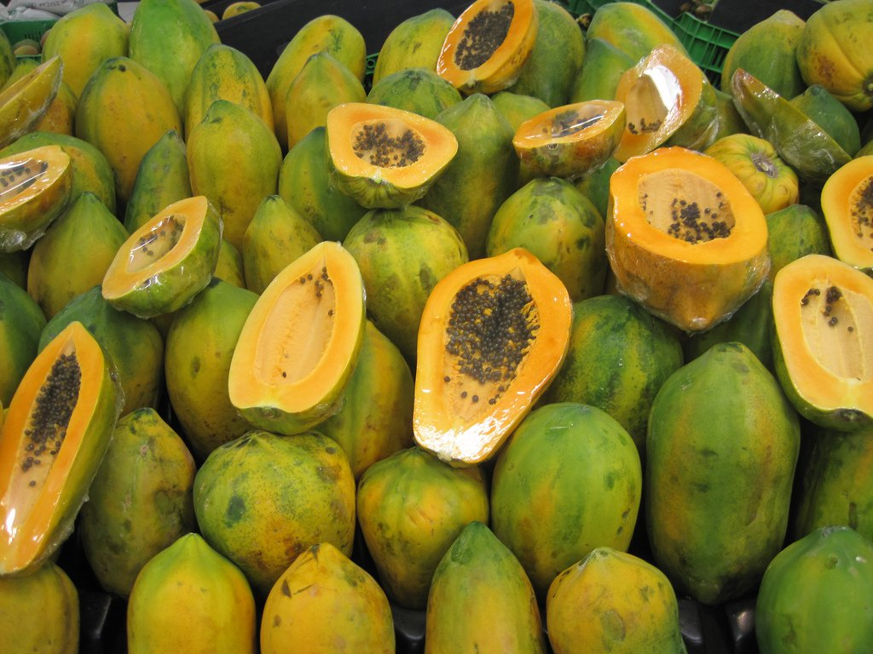
What are these? They’re _____.
ppapyas
papayas
payapas

Slide 24
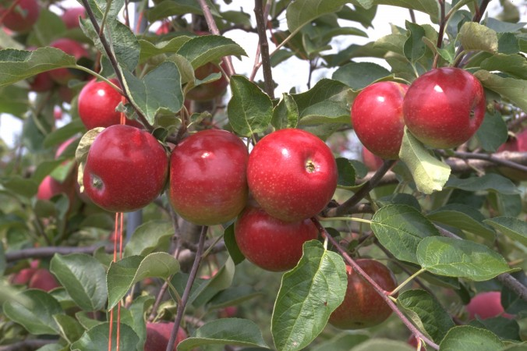
What are these? They’re _____.
cherries
grapes
apples

Slide 25
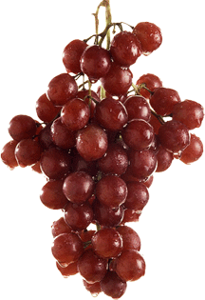
What are these? They’re _____.
gorillas
guavas
grapes

Slide 26
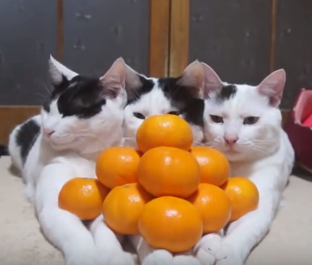
What are these? They’re _____.
oringes
octopus
oranges

Slide 27
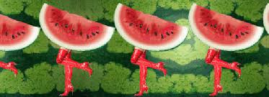
What are these? They’re _____.
watermelons waterfalls
waterpools

Slide 28
這個
那個
this / that
these / those
這些
那些

Slide 31
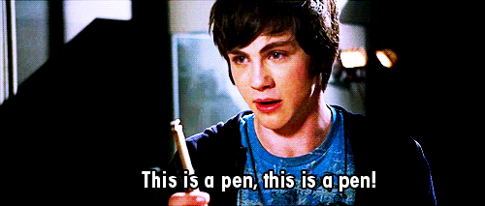
This
This

Slide 32
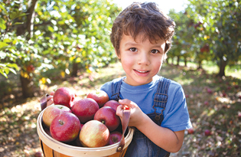
_______ are apples.
These

Slide 33
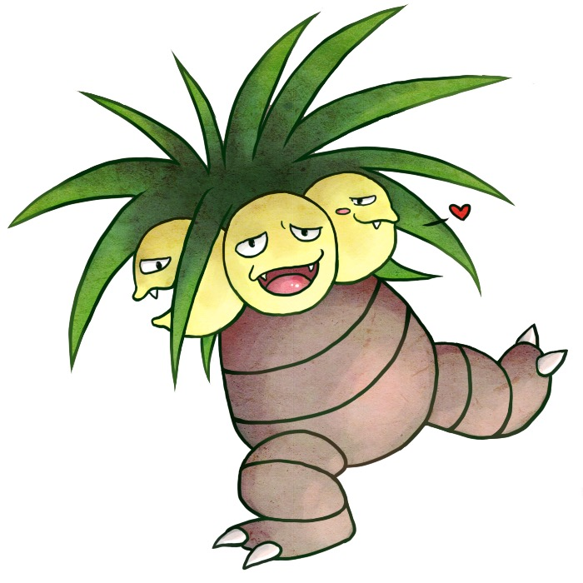
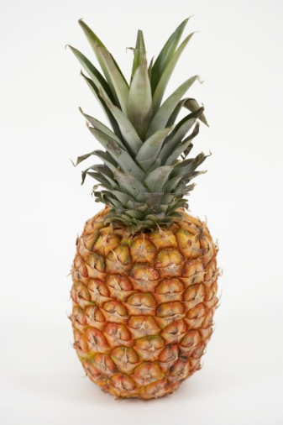
_____ is a pineapple.
That

Slide 34
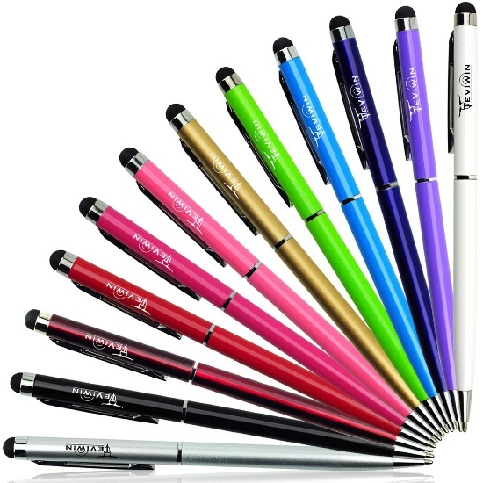
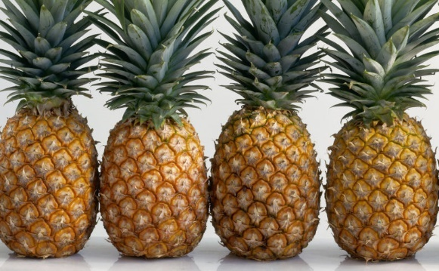
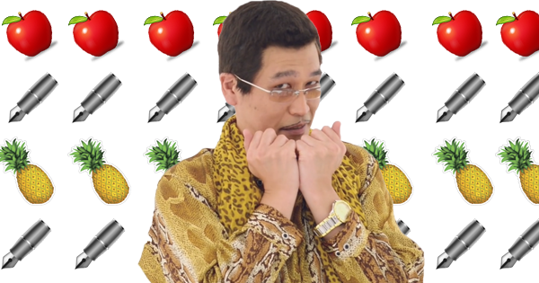
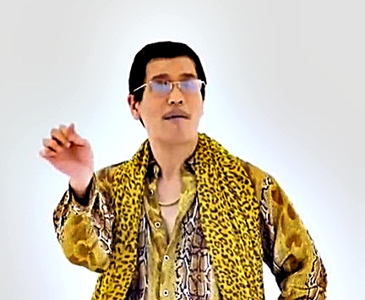
_____ are pens, pineapples and apples.
Those

Slide 36
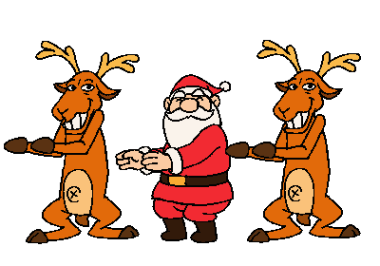
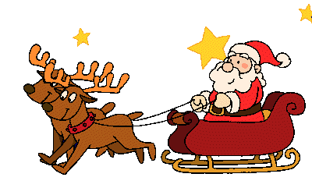
Let’s write a letter to Santa!

Slide 37
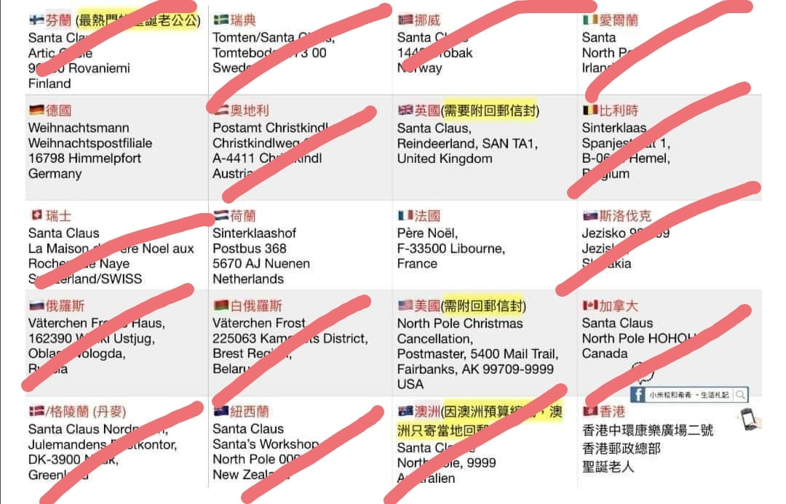

Slide 39
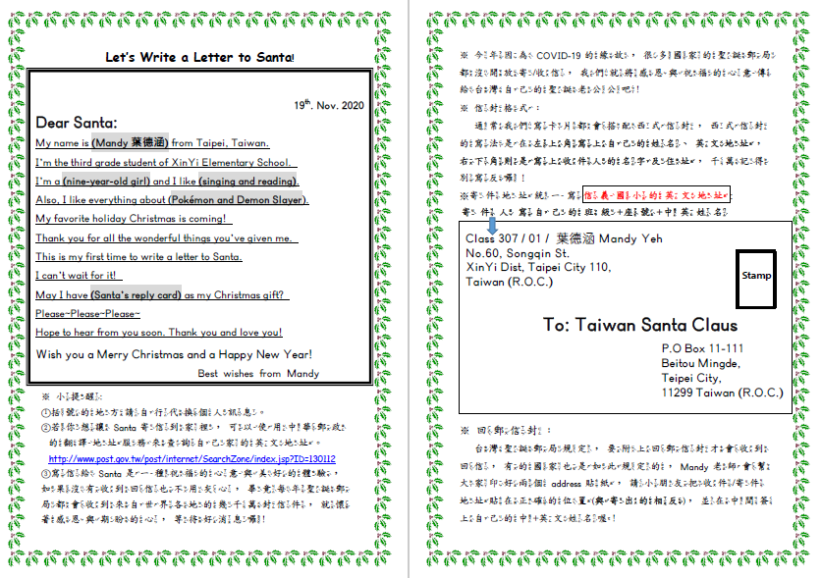

Slide 40
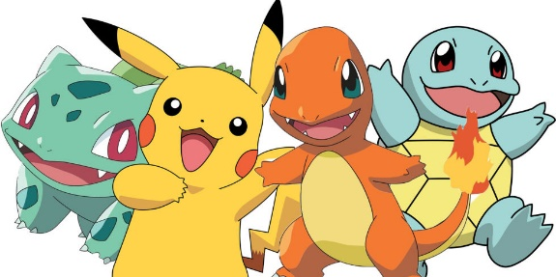
Homework this week
聽: CD2第11-19首。
說&讀:聽CD時跟著大聲唸。完成3遍
請家長在課本P51簽名可換印章。
完成: 寄給聖誕老公公的卡片(美編部分)
，下週第一堂英語課交。

